Slide 1
Brief Introduction of MarketScan NIKE Server Access
Yi Ding
August 2017
Notes:
This presentation focus on Access, navigation and resources. I will not talk the database in details. If you go to MarketScan box folder, you can find many useful info about the database

Slide 2
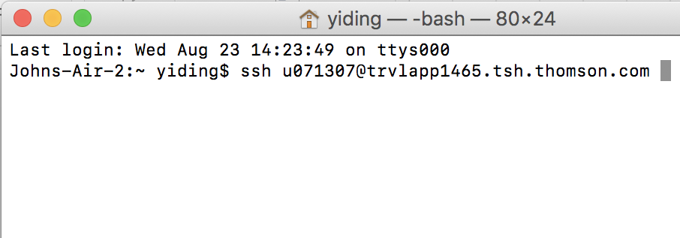
NIKE Server
MarketScan Databases capture person-specific clinical utilization, expenditures, and enrollment across inpatient, outpatient, prescription drug, and carve-out services.
Access with Terminal with ssh command
Notes:
The Truven Health MarketScan Databases capture person-specific clinical utilization, expenditures, and enrollment across inpatient, outpatient, prescription drug, and carve-out services. The data come from a selection of large employers, health plans, and government and public organizations. The Databases link paid claims and encounter data to detailed patient information across sites and types of providers and over time.

Slide 3
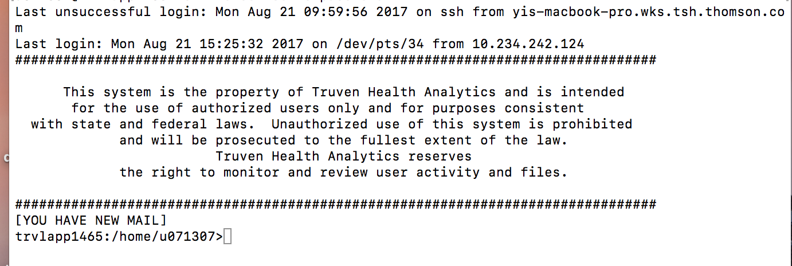
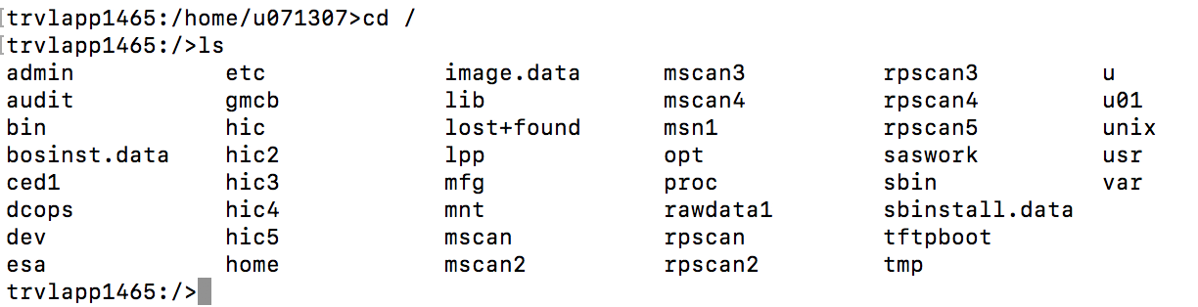
Home folder when login, use cd / to go to main folder

Slide 4
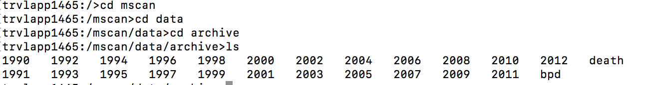
/mscan/data/archive: data from 1990 - 2012
/mscan2/data/archive: data from 2013 - 2016

Slide 5
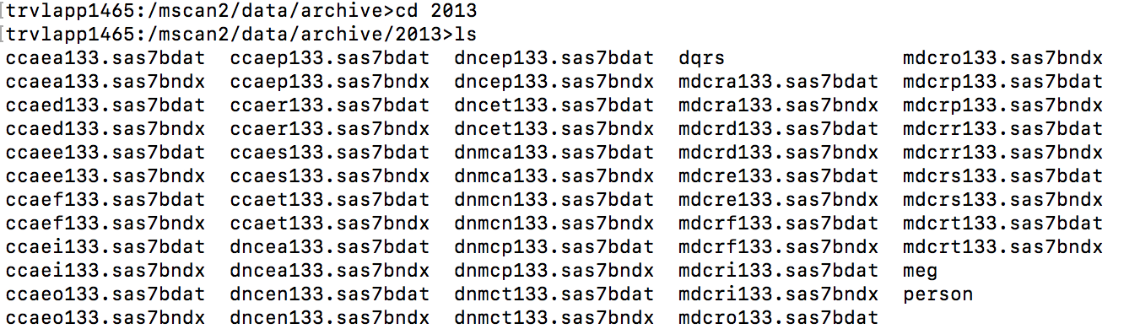
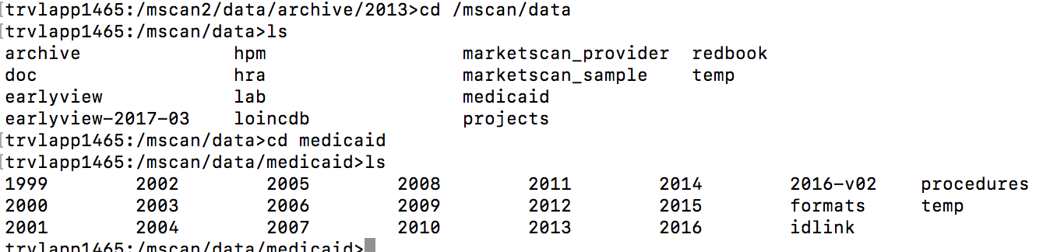
/mscan2/data/archive/2013: SAS datasets
ccae: Commercial Claims and Encounters Database
mdcr: Medicare Database
Medicaid Database: under /mscan/data/medicaid

Slide 6
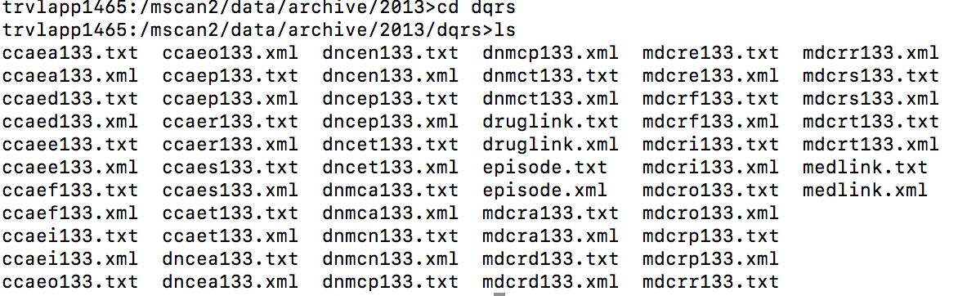
Data Dictionary and Statistics: dqrs (/mscan2/data/archive/2013)

Slide 7
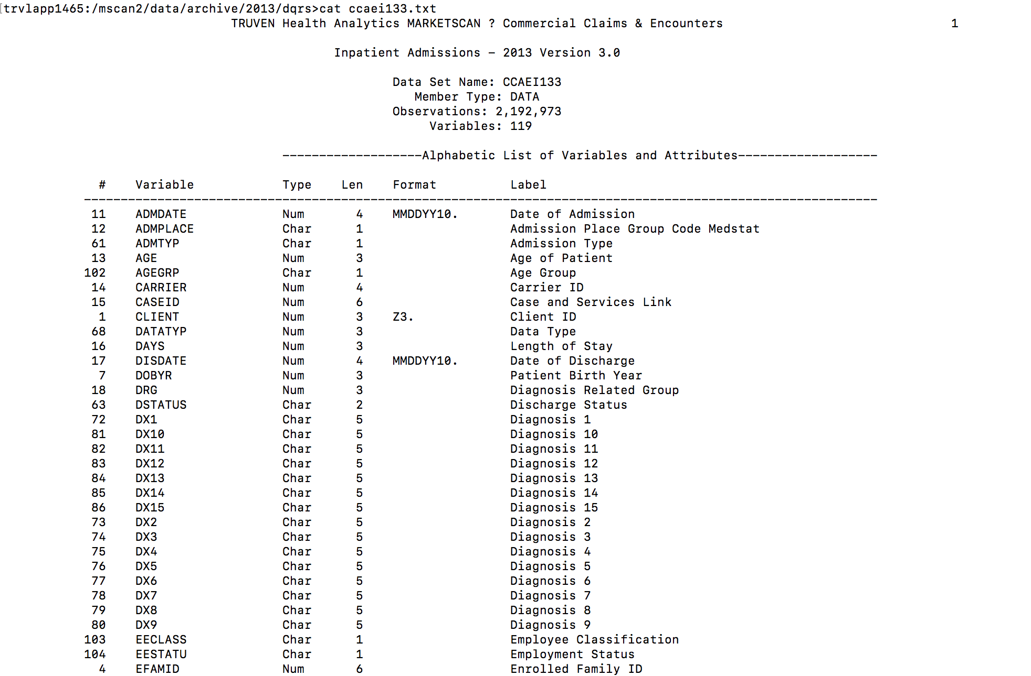
> cat ccaei133.txt

Slide 8
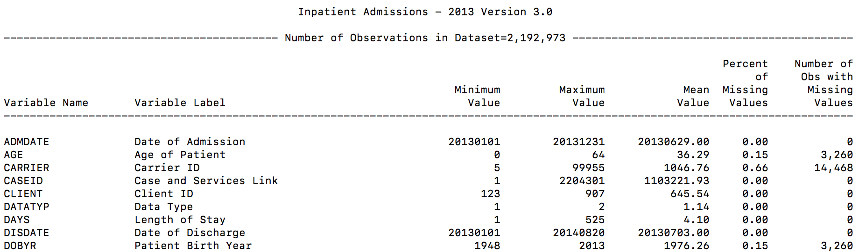
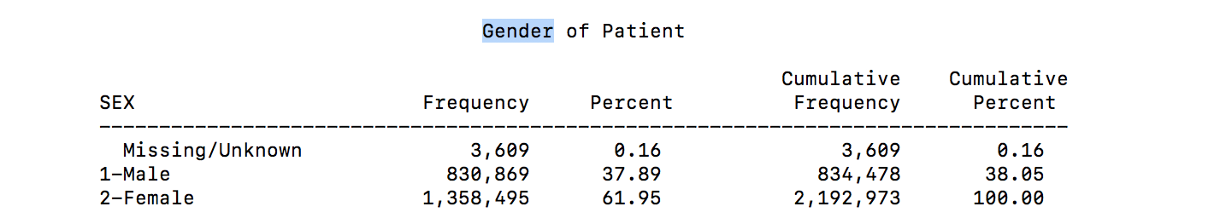
Statistics:
Coding logics of categorical variables:

Slide 9
SAS:
> sas sas_code_file.sas
Transfer files:
(Open a terminal (a new one, not logged in NIKE) ):
##### From local to NIKE #####
scp ~/Desktop/sas_code_file.sas u071***@trvlapp1465.tsh.thomson.com:/rpscan/u071***
##### From NIKE to local #####
scp u071***@trvlapp1465.tsh.thomson.com:/rpscan/u071***/project_folder/samplefile.csv ~/Desktop

Slide 10
Materials: MarketScan box folder under Training Materials
https://ibm.ent.box.com/folder/15042447682

